Slide 1

Polymorphism Analysis 2
M.J. Stear
BAHCM
University of Glasgow Garscube Estate

Slide 2
Aims
Discuss anatomy of a gene
Describe protein sequence analysis
Introduce multiple sequence alignment
Review polymorphism analysis

Slide 3
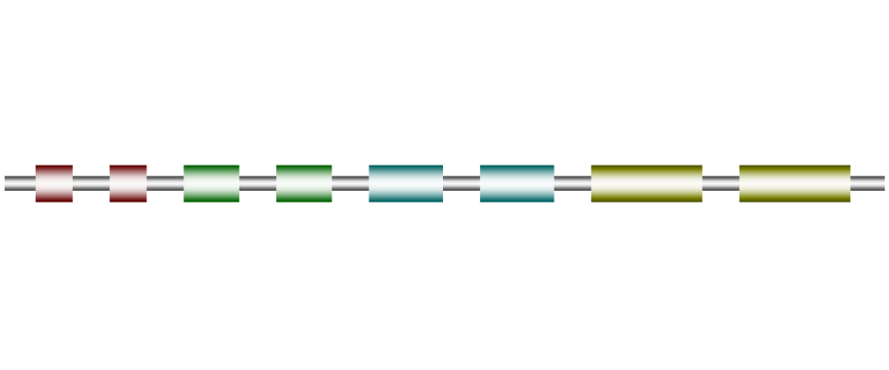
Anatomy of a gene
Repressors / Enhancers
/Transcription Factor Binding sites
Promoter
5’ UTR + Exon1
Splice sites
Introns
Exons +3’UTR

Slide 4
Polymorphism analysis
Coding region or functional DNA site
Non-synonymous vs Synonymous
Critical region of protein structure?
  Functional region
  Conserved region

Slide 5
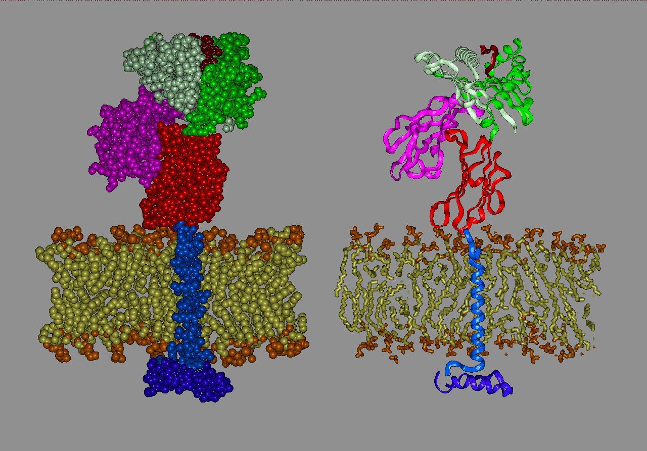
MHC Class I Molecule

Slide 6
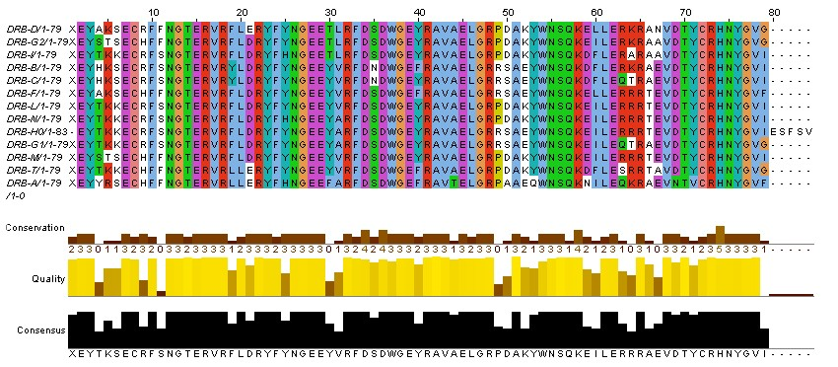
Multiple Sequence Alignment

Slide 7
BLOSUM
Align conserved regions (no gaps)
Count substitution frequencies
Calculate log-odds
Exclude all sequences more than 80% similar – BLOSUM80

Slide 8
Significance of AA substitutions Blosum62
  C S T
  C 9 -1 -1
  S -1 4 1
  T -1 1 4
  Protein evolution
  Protein function

Slide 9
AMINO ACID STRUCTURE
α-carbon
H
H₂N C COOH
R
amino group
carboxyl group
Side chain

Slide 10
Alanine A Ala
Sidechain –CH₃
Dull, non-reactive
Substitutes with other small AA

Slide 11

Arginine R Arg
Positively charged
Prefers substition with lys or polar AA
Active
  Bind phosphates

Slide 12
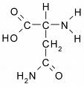
Asparagine N Asn
Positively charged
Active
  Cysteine proteases
  N-glycosylation

Slide 13
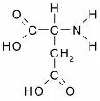
Aspartate D Asp
Negatively charged
Active
  serine proteases
Substitutes with Asn

Slide 14

Cysteine C Cys
Small, neutral
Intracellular, active
  zinc fingers
  cysteine proteases
Extracellular S-S
  immunoglobulins

Slide 15

Glutamine Q Gln
Substitutes with Glu
Active

Slide 16
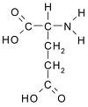
Glutamate E Glu
Negatively charged
Substitutes with Asp

Slide 17
Glycine G Gly
Side chain –H
Smallest AA, flexible, can bind phosphates
  Collagen
Substitutes with small AA

Slide 18

Histidine H His
Positively charged
Does not substitute well
Very active
  Easy to move protons
  Serine proteases

Slide 19
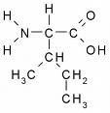
Isoleucine I Ile
Hydrophobic
Cβ branched (V & T)
  Bulky backbone
  Not α helices
Fairly non-reactive
Recognition of hydrophobic ligands

Slide 20
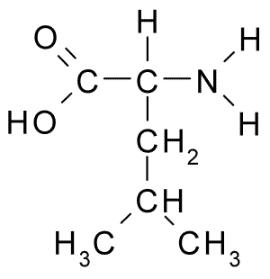
Leucine L Leu
Aliphatic
Prefers α-helices

Slide 21
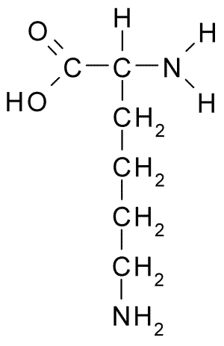
Lysine K Lys
Positively charged
Amphipathic
Active
Substitutes with arg

Slide 22

Methionine M Met
Hydrophobic
Fairly non-reactive
S atom can assist metal binding

Slide 23

Phenylalanine F Phe
Very hydrophobic
Similar to tyrosine
Stacking interactions
Fairly non-reactive

Slide 24

Proline P Pro
Unique
Kinky
Often on protein surface

Slide 25

Serine S ser
Substitutes with small, polar AA Thr
Common in tight turns
Active
  Proteases and lipases
  Phosphorylation
  O-glycosylation

Slide 26

Threonine T Thr
Small, polar
  Can occur in protein
Cβ branched
Active
  Hydrogen bonds
  Phosphorylation
  O-glycosylation

Slide 27

Tyrosine Y Tyr
Partially hydrophobic
Stacking interactions
Phosphorylation
Substitutes with aromatic AA

Slide 28
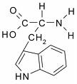
Tryptophan W Trp
Unique chemistry/size
Substitutes with aromatic AA
More reactive than F
Bind non-protein atoms (rare)

Slide 29
Valine V Val
Side chain CH
/ \
CH₃ CH₃
Hydrophobic core

Slide 30
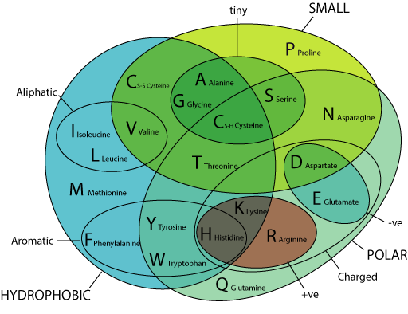
Properties of Amino Acids

Slide 31
Summary
Anatomy of a gene
Multiple sequence alignment
Analysis of protein sequences
Polymorphism analysis

